Slide 2
First-Fit Allocation
It is a memory allocation technique used in operating systems to allocate memory to a process.
In First-Fit, the operating system searches through the list of free blocks of memory, starting from the beginning of the list, until it finds a block that is large enough to accommodate the memory request from the process.
Once a suitable block is found, the operating system splits the block into two parts: the portion that will be allocated to the process, and the remaining free block.

Slide 3
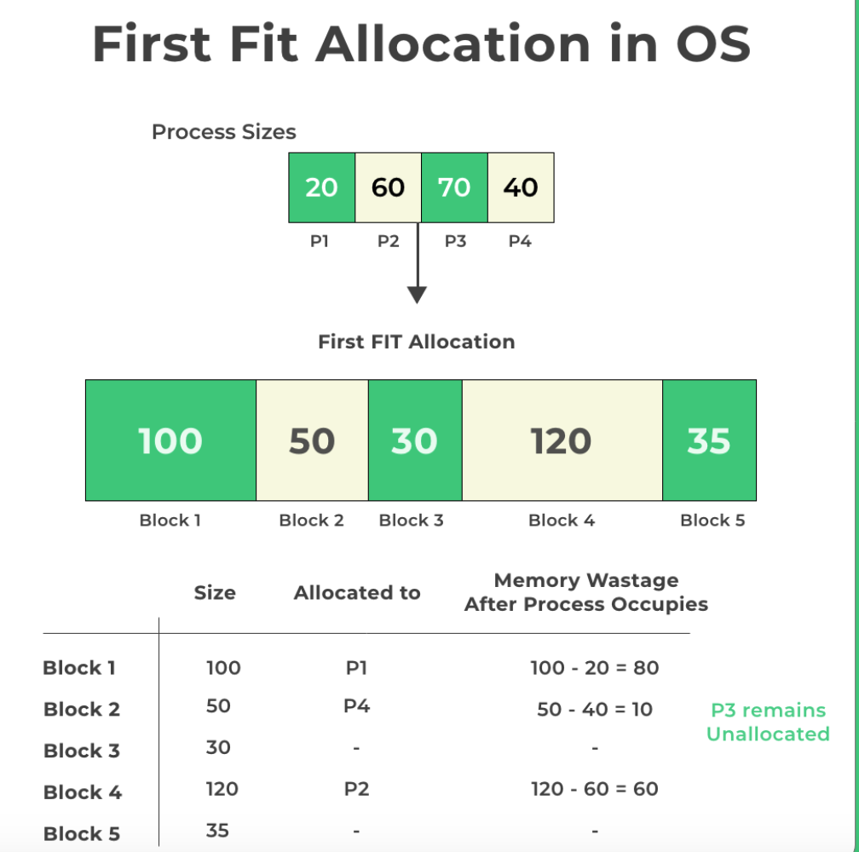

Slide 4
First-Fit Allocation
Advantages of First-Fit Allocation include its simplicity and efficiency, as the search for a suitable block of memory can be performed quickly and easily.
Additionally, First-Fit can also help to minimize memory fragmentation, as it tends to allocate memory in larger blocks.

Slide 5
First-Fit Allocation
Disadvantages of First-Fit Allocation include poor performance in situations where the memory is highly fragmented, as the search for a suitable block of memory can become time-consuming and inefficient.
Additionally, First-Fit can also lead to poor memory utilization, as it may allocate larger blocks of memory than are actually needed by a process.

Slide 6
Best-Fit Memory Allocation:
This method keeps the free/busy list in order by size – smallest to largest.
In this method, the operating system first searches the whole of the memory according to the size of the given job and allocates it to the closest-fitting free partition in the memory, making it able to use memory efficiently.
Here the jobs are in the order from smallest job to largest job.

Slide 7
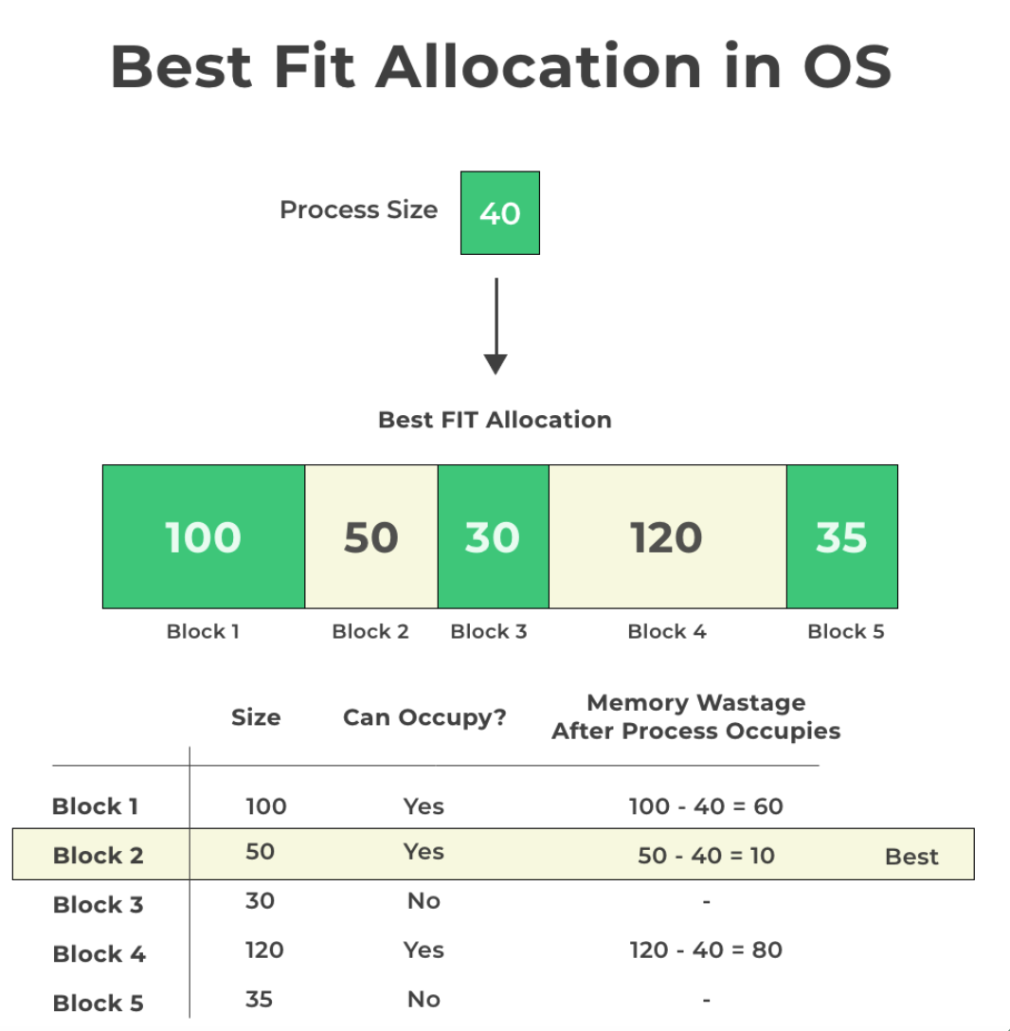

Slide 8
Best-Fit Memory Allocation:
Advantages of Best-Fit Allocation :
Memory Efficient. The operating system allocates the job minimum possible space in the memory, making memory management very efficient.
To save memory from getting wasted, it is the best method.
Improved memory utilization
Reduced memory fragmentation

Slide 9
Best-Fit Memory Allocation:
Disadvantages of Best-Fit Allocation :
It is a Slow Process. Checking the whole memory for each job makes the working of the operating system very slow. It takes a lot of time to complete the work.
Increased computational overhead
May lead to increased internal fragmentation
Can result in slow memory allocation times.

Slide 10
Worst-Fit Memory Allocation :
In this allocation technique, the process traverses the whole memory and always search for the largest hole/partition, and then the process is placed in that hole/partition.
It is a slow process because it has to traverse the entire memory to search the largest hole.

Slide 11
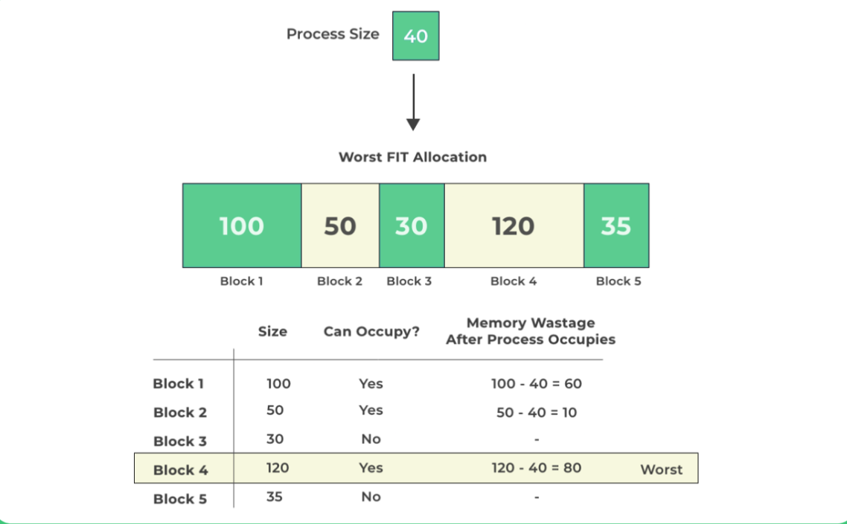

Slide 12
Worst-Fit Memory Allocation :
Advantages of Worst-Fit Allocation :
Since this process chooses the largest hole/partition, therefore there will be large internal fragmentation.
Now, this internal fragmentation will be quite big so that other small processes can also be placed in that leftover partition.

Slide 13
Worst-Fit Memory Allocation :
Disadvantages of Worst-Fit Allocation :
It is a slow process because it traverses all the partitions in the memory and then selects the largest partition among all the partitions, which is a time-consuming process.

Slide 14
Paging
Paging is a memory management technique in operating systems that enables processes to access more memory than is physically available.
The system improves performance and resource utilization and reduces the risk of page faults.
This method is also known as swapping in Unix-like systems.

Slide 15
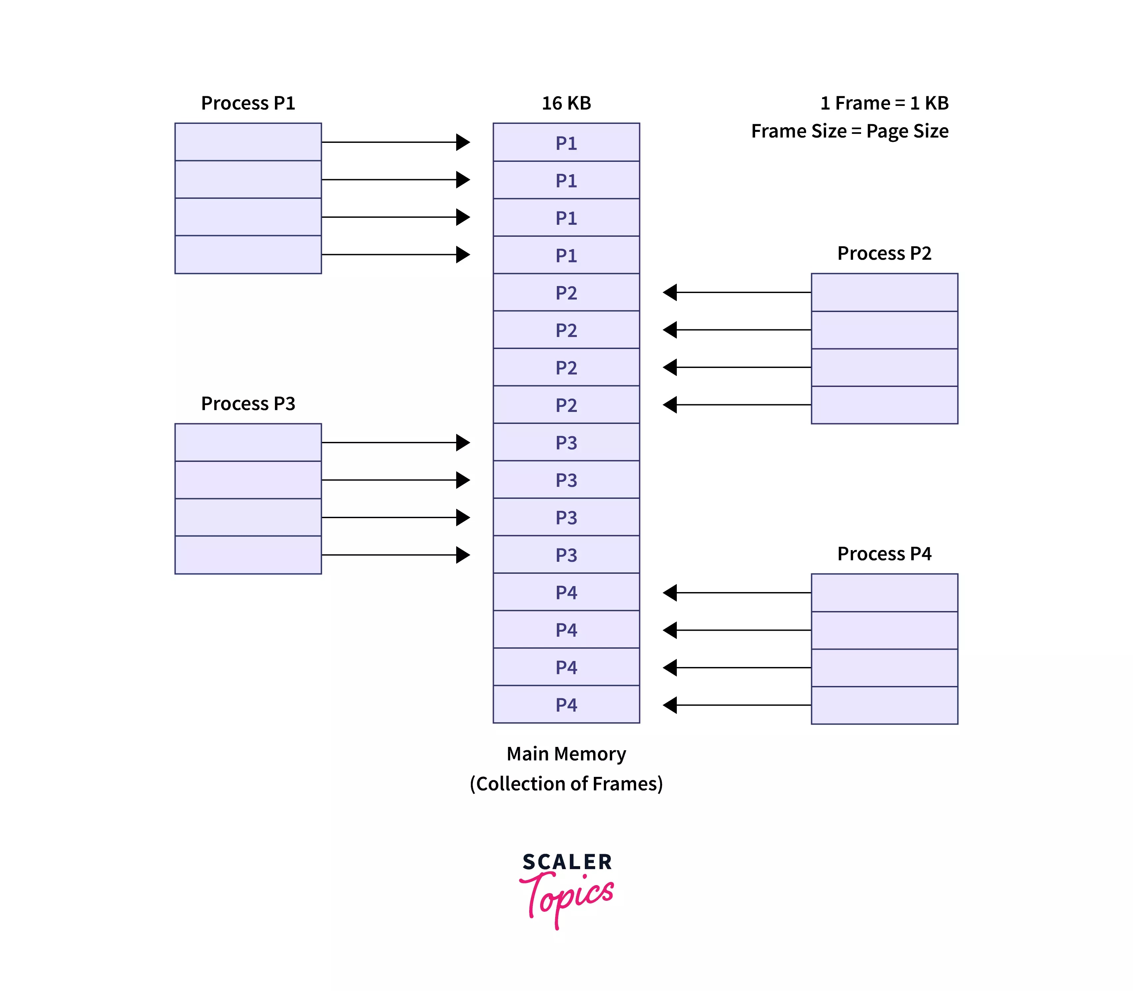
Contigous allocation in paging

Slide 16
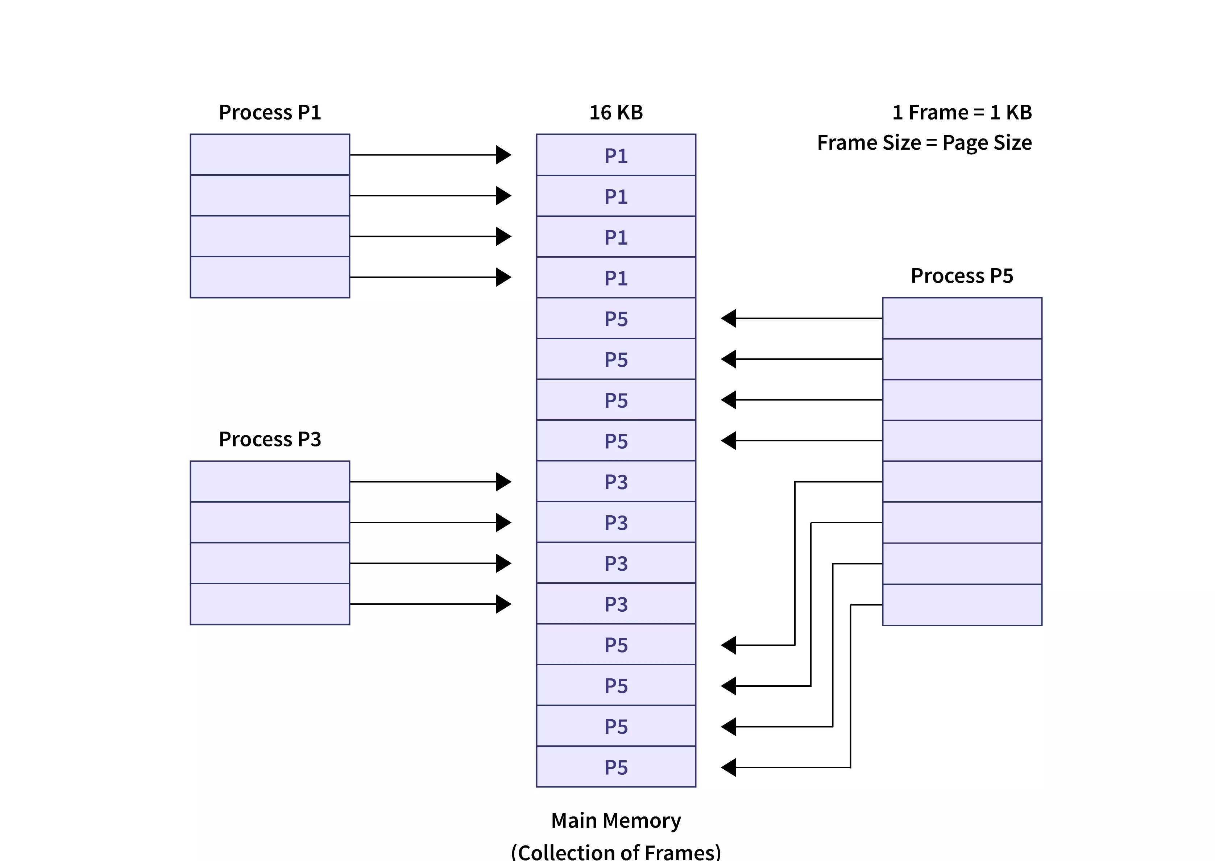
Non Contigous allocation

Slide 17
Segmentation
Segmentation divides processes into smaller subparts known as modules.
The divided segments need not be placed in contiguous memory.
Since there is no contiguous memory allocation, internal fragmentation does not take place.
The length of the segments of the program and memory is decided by the purpose of the segment in the user program.

Slide 18
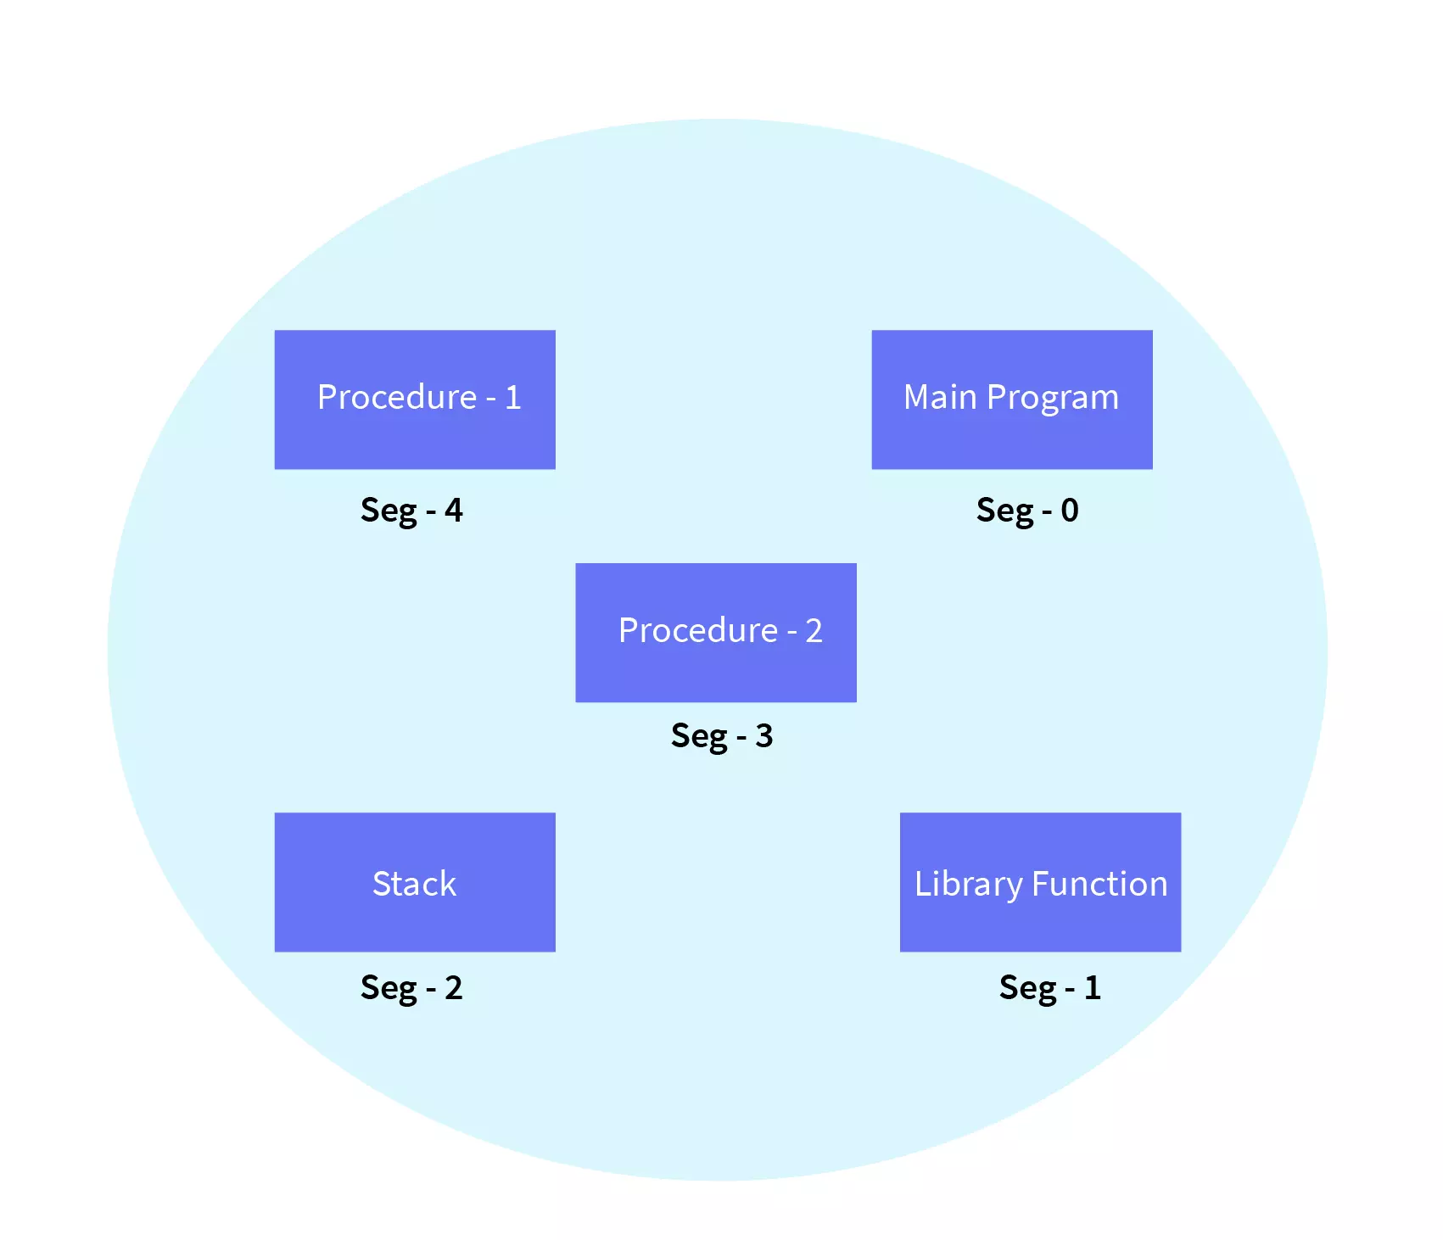

Slide 19
Why Segmentation is required?
Segmentation came into existence because of the problems in the paging technique.
In the case of the paging technique, a function or piece of code is divided into pages without considering that the relative parts of code can also get divided.
Hence, for the process in execution, the CPU must load more than one page into the frames so that the complete related code is there for execution.
Paging took more pages for a process to be loaded into the main memory. Hence, segmentation was introduced in which the code is di

Slide 20
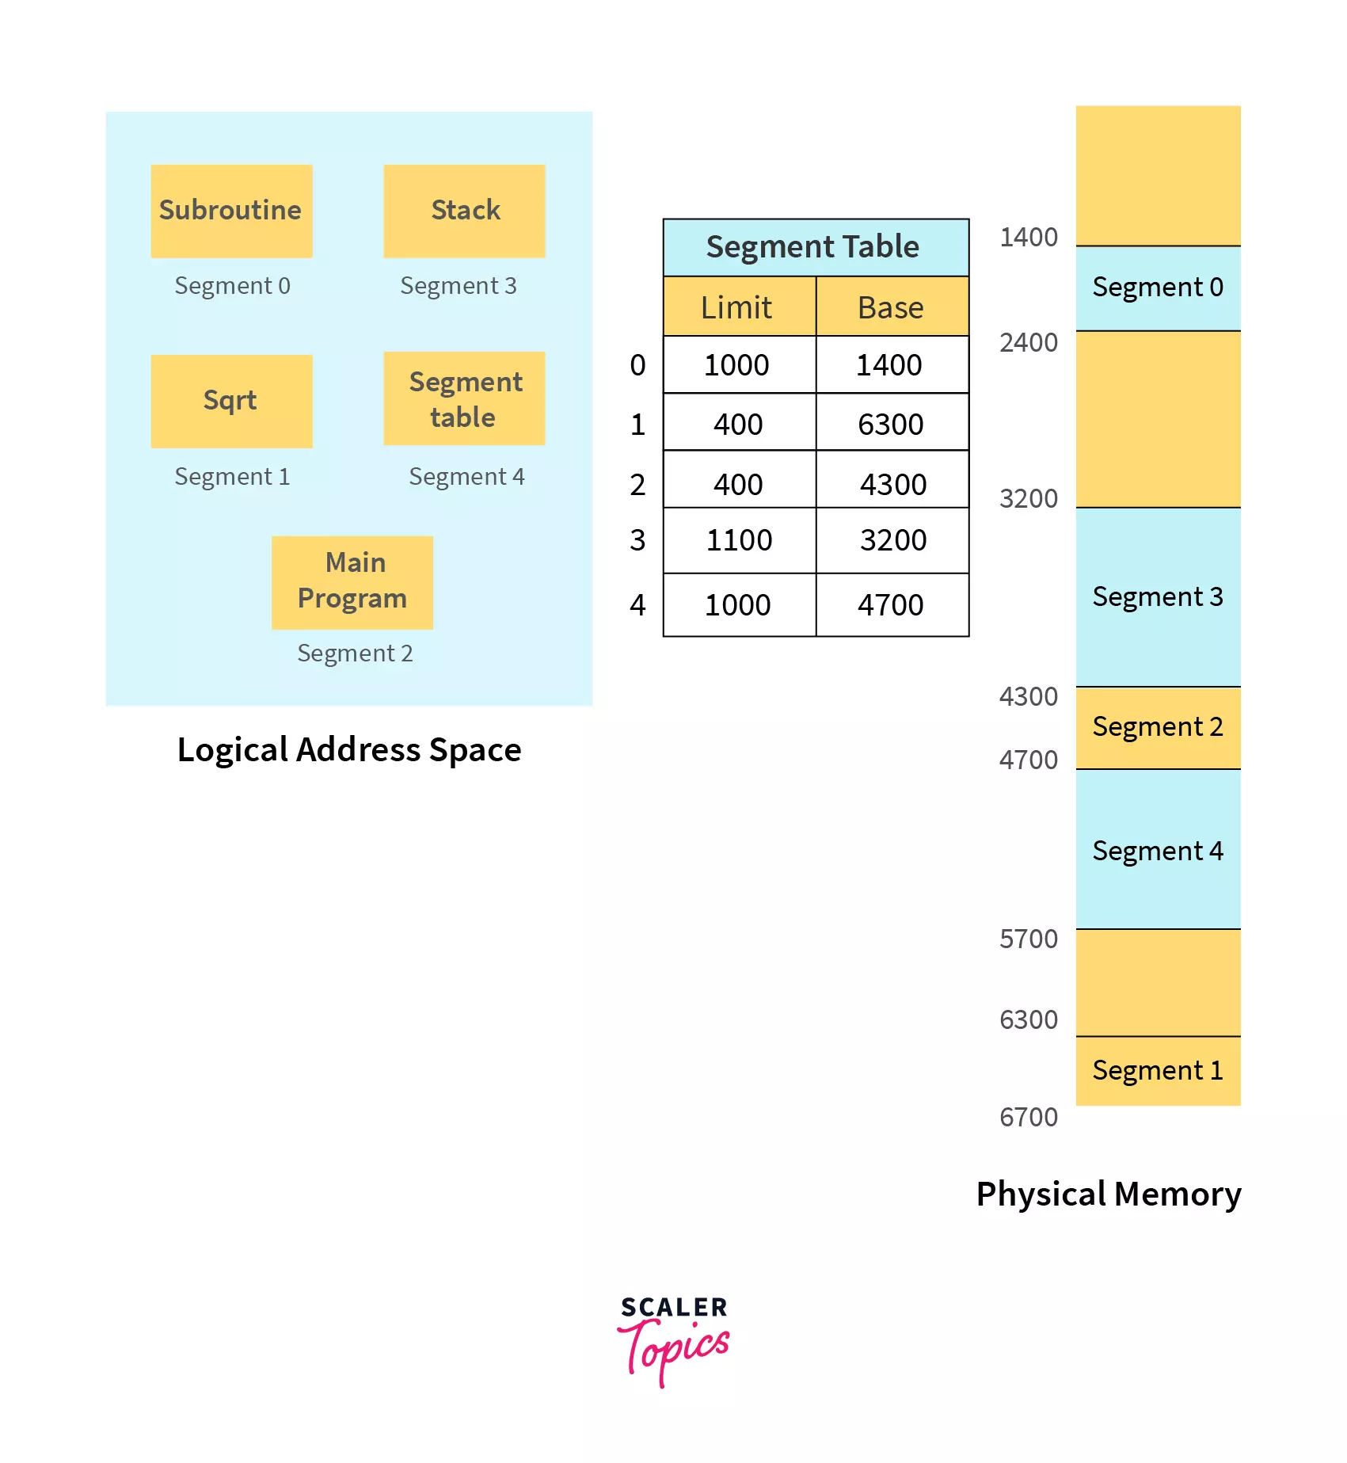

Slide 21
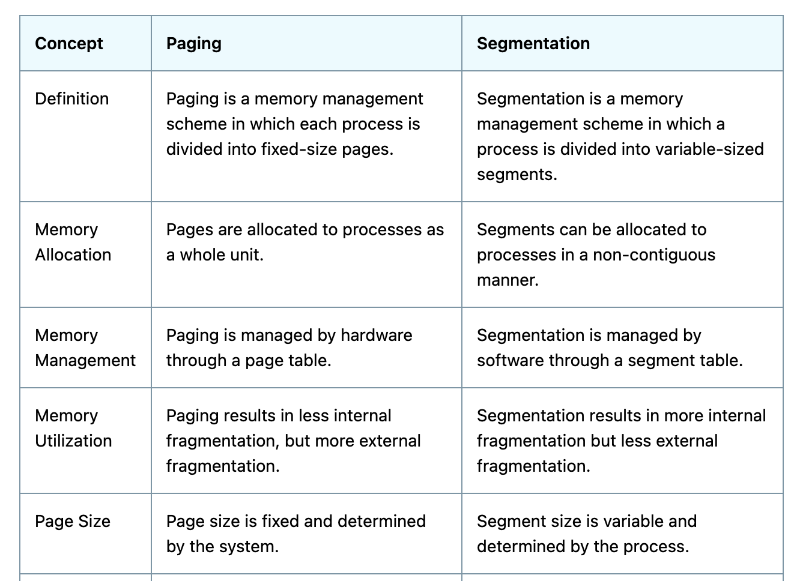

Slide 22
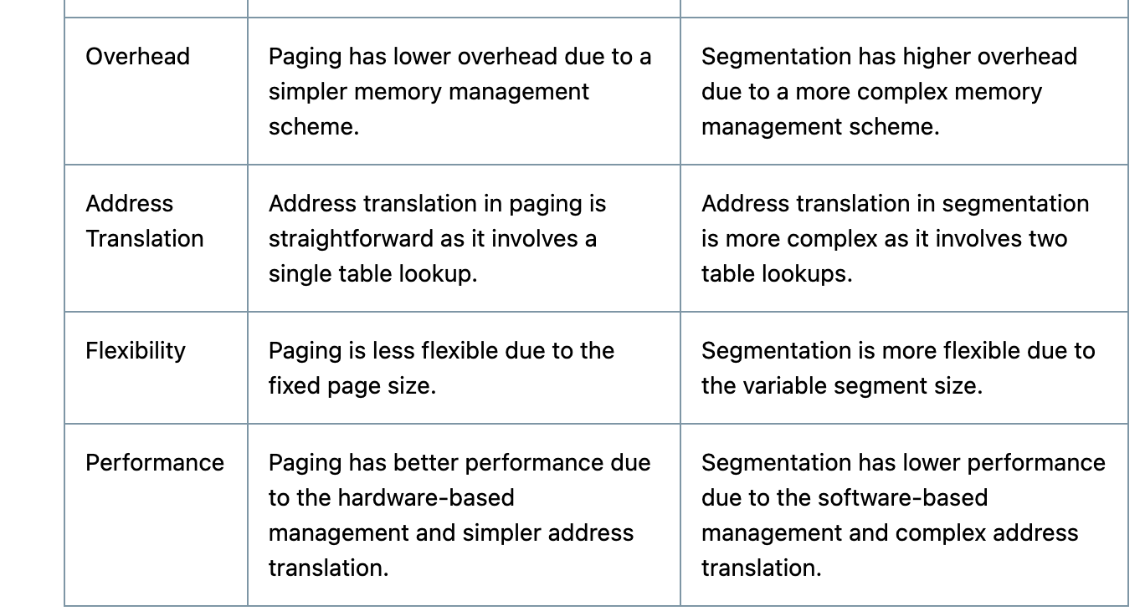
v

Slide 23
https://youtu.be/p9yZNLeOj4s?si=ooTBsK1WV1kYVvXk

